Slide 1
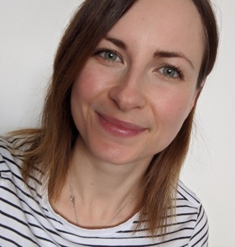
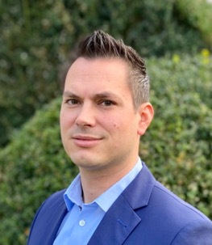
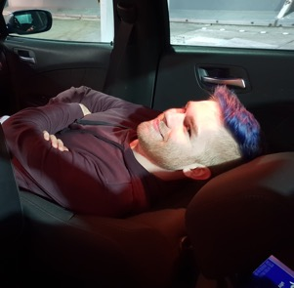
Who are we?
Lisa Dahms
Senior HR Manager Learning & Development
Christian Rudolph
Head of DevOps Transformation
Philipp Böschen
DevOps Evangelist / Coach
TRUSTED
UNIQUE
INSPIRING
Notes:
General Intro: CR
Intro people - everyone

Slide 2

TUI before the Corona crisis: world market leader in tourism
€19Billion
Revenue FY19
€1.2Billion
Underlying EBITA FY19¹
>€1Billion
Investments FY19
27Million
Customers FY19
+20%
Planned turnover FY20 before Corona crisis
+17%
Booked turnover January 2020, comparison to previous year
1- excl. Boeing 737 MAX Effect
Notes:
CR presents TUI

Slide 3
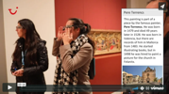
Where we started
Digital disruption
New players​
New innovations
Leading instead of react​ing
Central Region
Northern Region
Western Region
Notes:
Slide CR

Slide 4
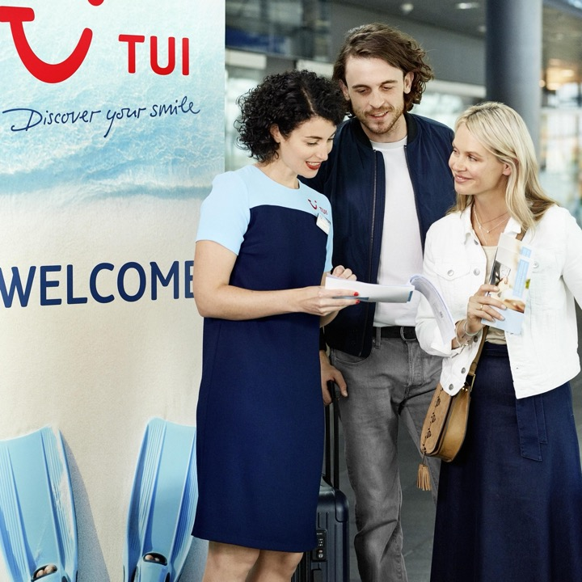
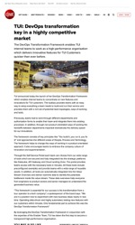
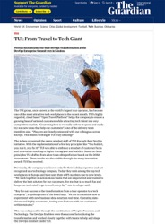
The plan to transform
3-4 years migration to new TRIPS system
Business harmonization over time
Upskilling / Skill shift in workforce
Notes:
Slide CR

Slide 5


Skill Shortage … by 2025:
50% of employees need to move into new roles
When remaining in current role: update ≤40%
of skill set
Train over 70% of employees
Jobs of tomorrow: DevOps Engineers and AI specialists.
Invest in intensive re- & upskilling
of workforce required.
Research by World Economic Forum 2020 „what will the future of jobs be like“

Slide 6

…and then Covid came around:
Impacts
Goals
Actions
91% reduction in customers
98% loss in turnover
Seek financial aid from the German government
Net burn rate reduced by 70%
Liquidation of existing assets
Reduce cash out
1/3 loss of workforce in IT (reduced contractors)
Furlough/reduced capacity of remaining staff
HR development paused
From 330 to 45 projects
Notes:
2.5 million customers p.a. – only 10% "normal" year
6.1 bn in finance package
• IT FTE reduction of 55%
Wieviel MA haben wir????
„Life is what happens while you´re busy making other plans“ (John Lennon)

Slide 7

What we had to cope with…
„Work smarter, not harder“
New technical features required to adopt to new reality
New responsibilities for workforce emerged
Scaling of skill landscape
Dramatically limited financial resources

Slide 8

DevOps coaching
Metrics
Organization
for:ward

Slide 9
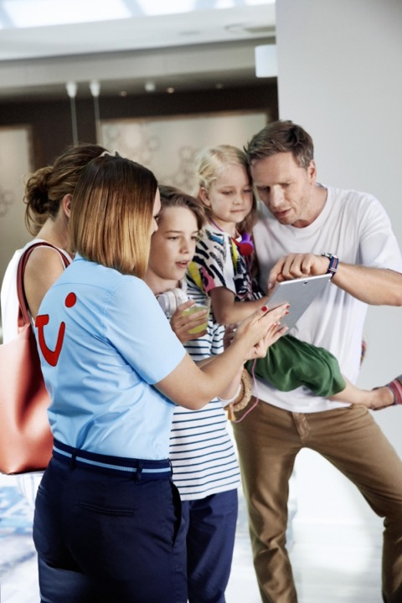
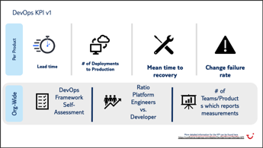
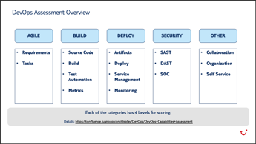
DevOps Coaching
Established DevOps CoP
Best practices – tool expertise
DevOps Maturity Model
Metrics

Slide 10

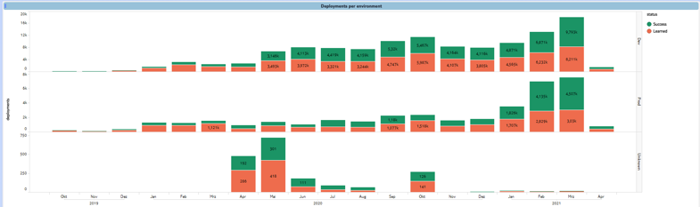
Stable delivery
Use existing deployment pipelines from our central VCS
Central team of enabling engineers to support struggling teams
Notes:
- Focus on gathering data independently from teams so they can focus on their delivery

Slide 11

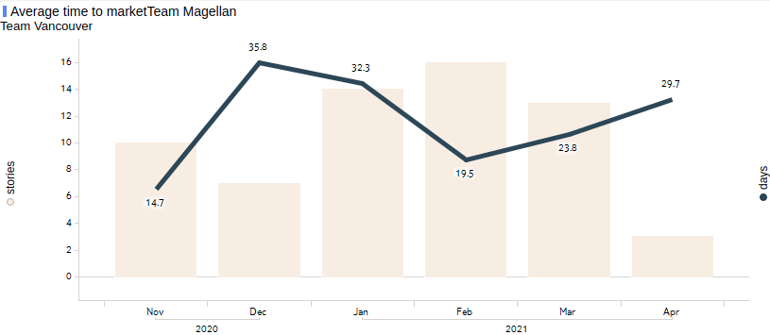
Cycle time
Adaptability to our environment will be the key to survival
Smaller batches decreases cycle time for work items
Notes:
Image source: https://pixabay.com/photos/new-zealand-queenstown-paradise-2490423/ Copyright free for commercial use without attribution

Slide 12
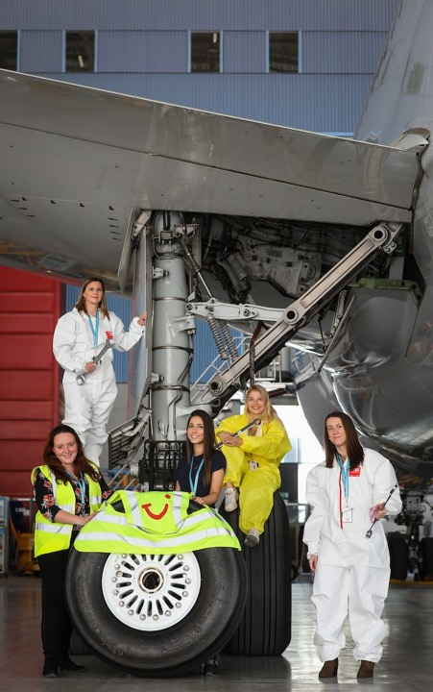
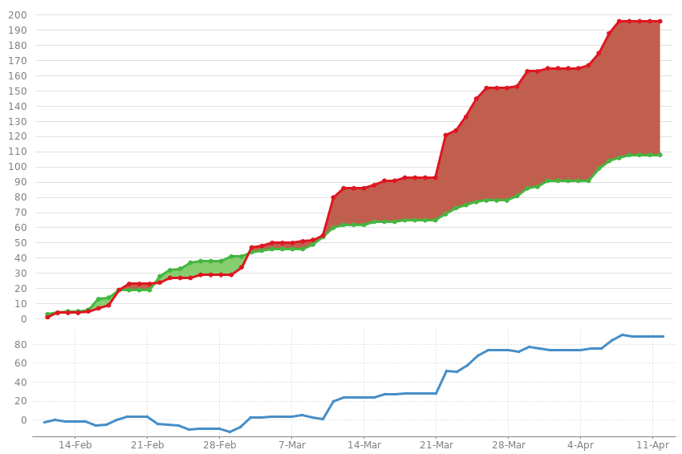
Technical debt
Raise awareness that our focus on speed will incur debt
Collect our debt so we can make informed decisions on our risk

Slide 13

Refocus
Limit WIP
Fast feedback
Remove context switching
Increased velocity
Shared goals
Less conflicts
Increased motivation

Slide 14

Accelerate
Product organization
One global organization – OneIT
Do things once but right
Culture
Everyone works remotely
Digitalization first
Embrace knowledge sharing

Slide 15

ONE IT
Regions
Group IT
Before
Central
Digital Platforms
Northern
Western
Corporate Systems
….
OneIT
Now
Product
Sourcing Hotels
…
Sales
Commercial
Sourcing Flights

Slide 16

for:ward
Global, long-term development programme
All colleagues within IT Domain Organisation in scope
Centrally funded
2 streams to build programme foundation: role transition & on-demand learning
New work mindset
Peer learning & interaction
At TUI, continuous learning is a natural part of business delivery.

Slide 17

for:ward
Stream
Role Transition
On-demand Learning
Focus
Intensive re- & upskilling
Learning 24/7
Kick-off
May 21
March 21
Learning Provider
Udacity
Udemy
Learning path
Data Analyst
Data Engineer
Data Scientist
DevSecOps Eng.
Not
pre-determined
Time Invest
3-6 months per learning path,
30-50% of time
Course-driven,
Local TUI L&D initiatives to accelerate

Slide 18

We want to take our employees with us on our DevSecOps journey and train them on the latest skills. This will make our employees and TUI fit for whatever comes next and enable us to shape our own future.
Elke Reichart, CDO TUI
Many colleagues have put a lot of thought into designing the programme – from HR as well as IT. This helped to create a development programme of real value for our people and increased mutual understanding for the processes and requirements “behind the scenes”.
Frank Rosenberger, CIO TUI
We will become a learning organisation and this helps us to accelerate our digital transformation.
Cerstin Lang, HR Director Group IT
The for:ward program came exactly at the right time. With for:ward we can now perfectly transition into a much-needed skillset in our department. The perfect solution for manager and employee with a clear path.
Henning von Roon, Head of Analytics Capabilities
Learning is something that gets not enough attention on the job so having the opportunity to do focused and guided learning is really valuable. The for:ward program allows me to get ready for a new position while making me better at my current role. I am excited to start!
Jens Mohme, IT Developer TUI

Slide 19

Learnings
We can handle a crisis
Coaches have a big impact on the team success
Upskilling of people is more important than ever
Clear shared goals foster commitment and focus
Invest in your people, they pay it back!
Notes:
We are experiencing

Slide 20
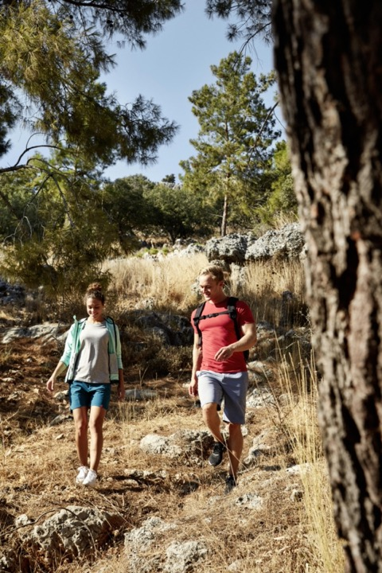
Next challenges…
Reopening of offices – impact on teams
Make technical debt actionable
Continuously measure success of established practices
Clear shared goals are important
We would love to hear about your experience

